Slide 1
Flutter Stateless Widgets
DMIT 2504 Week 2 day 1

Slide 2





Announcements
Notes:
Frustrations with coding, assignment pressure, all is normal. Overwhelmed is normal, if you need help reach out.
Assignment 1 Due September 20th (Friday)
When you are running your assignments make sure to run dart analyze and dart test. You should have no errors and pass everything

Slide 3
Expectations
No Late Assignments
No Cheating
Be a good classmate
Don’t go to stupid sites in class
Show up to class

Slide 4
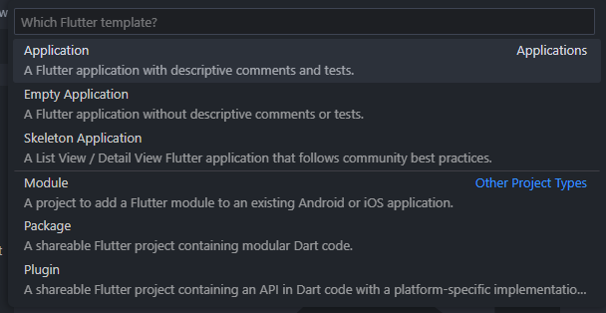
Recap: Create a Flutter Project
VS Code
Ctrl + shift + p
Flutter: New Project
Application
Terminal
Flutter create <path to create in>

Slide 5
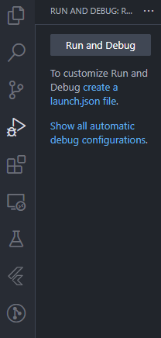
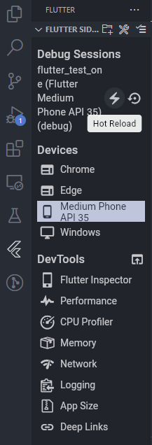
Recap: Run a flutter project
In VS Code
Ctrl + f5
F5
Using the sidebar
Reload in sidebar
In Terminal
flutter run
Reload with “r”

Slide 6

What is a widget?
Pretty much everything you see (and some things you don’t) in a flutter app is a widget
Visible elements
Layout elements
Functional elements

Slide 7
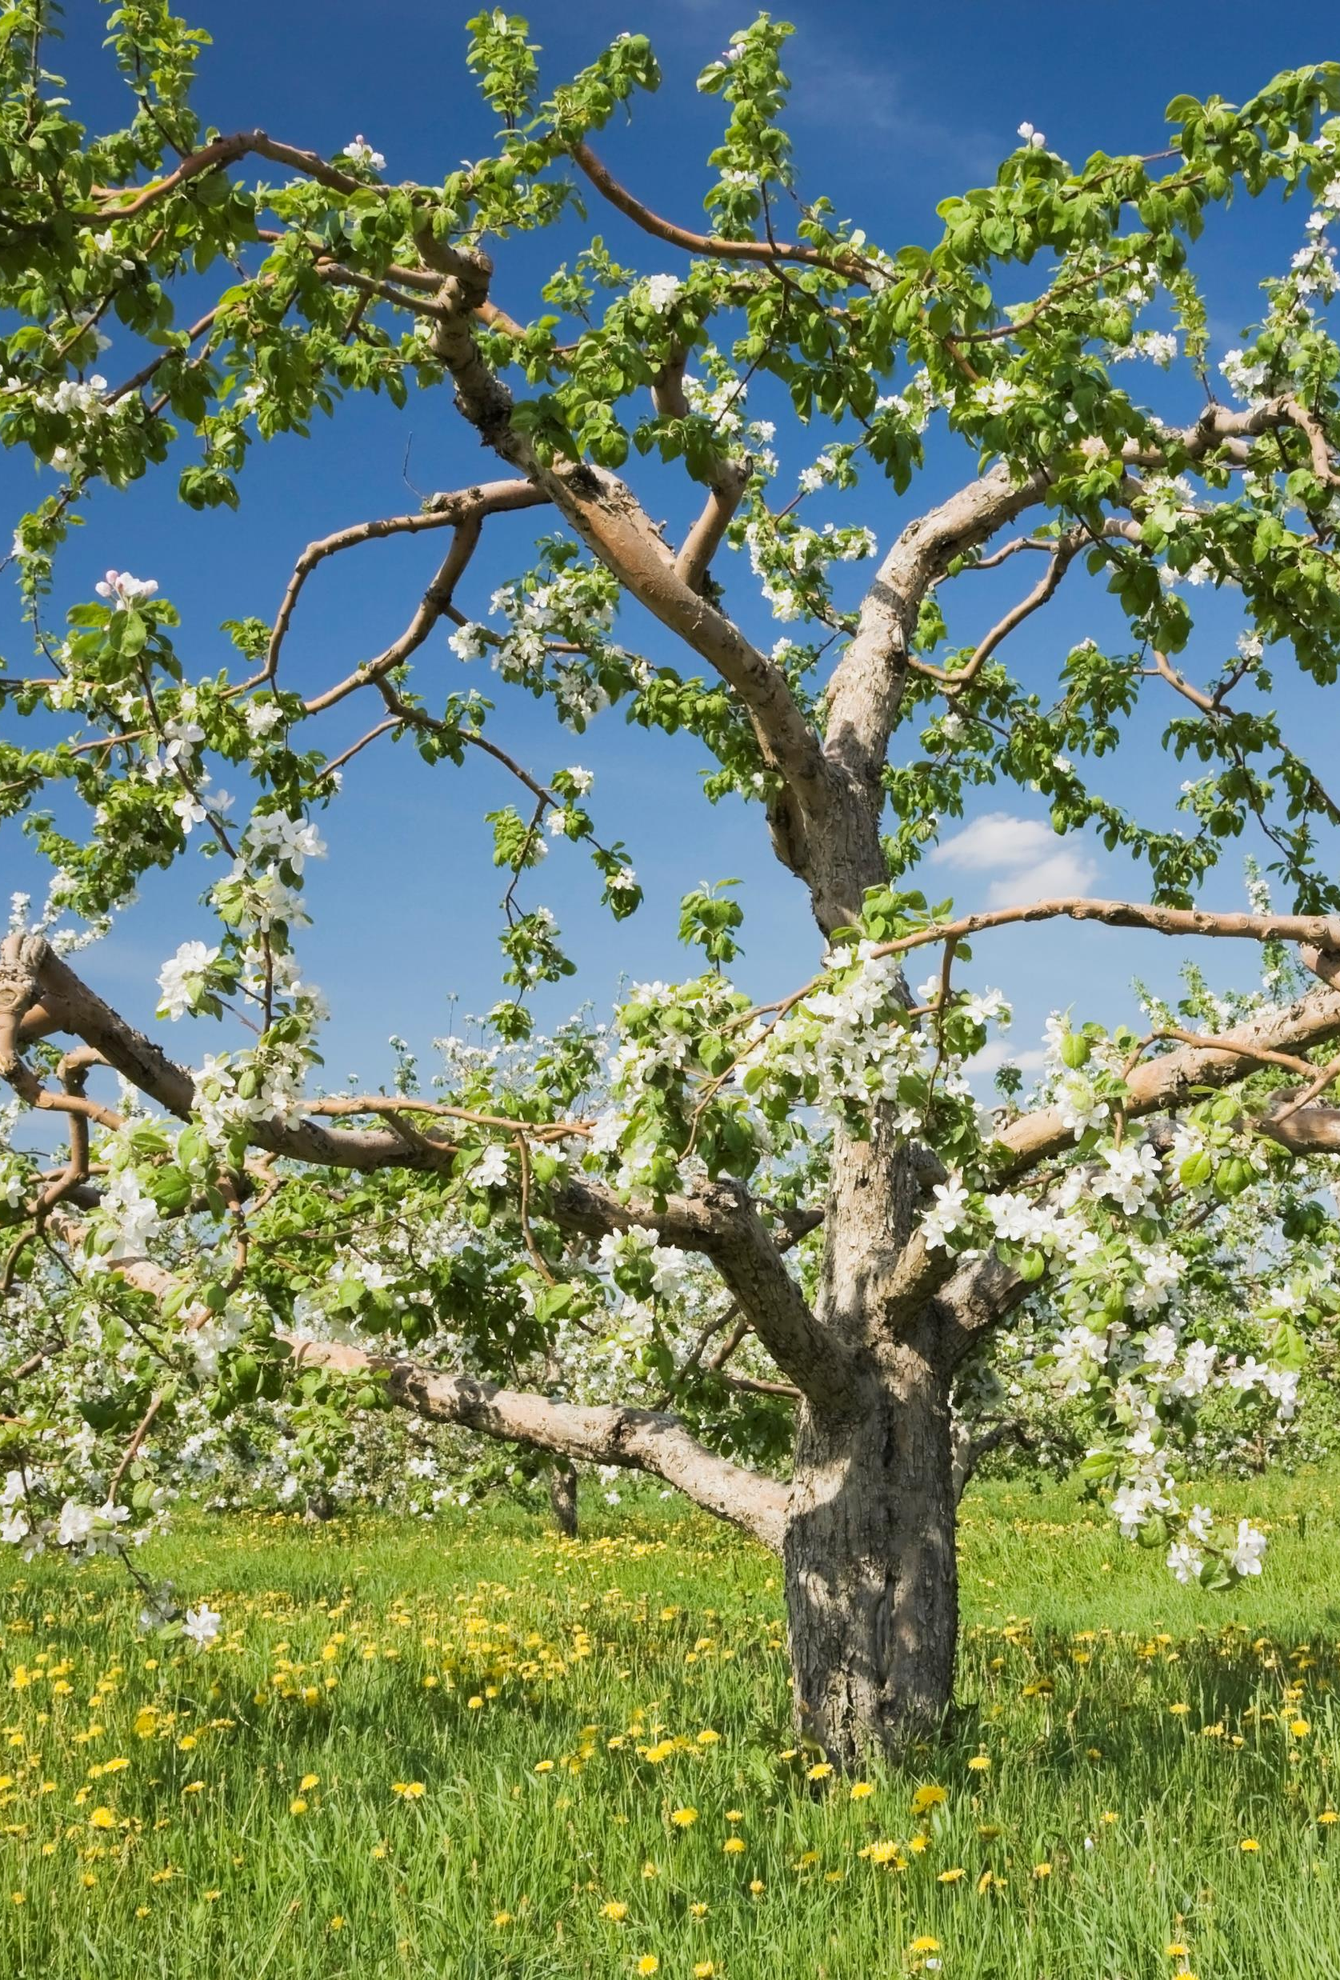
The widget tree
All flutter apps are laid out in a tree structure
Widgets can have children, and those widgets can have children and so on…
Some widgets have a children property, accepting a list of widgets
Other widgets have a child property, accepting only a single widget
Others can’t have children and are self-contained
Notes:
Explain tree structure, draw it out on the board

Slide 8
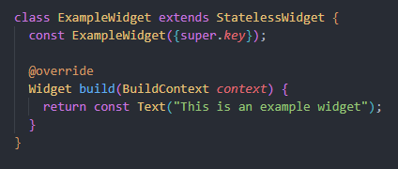
Stateless Widgets
The default widget does not have state – It is created and then stays the way it is
In flutter StatelessWidget is a class that Widgets can extend
Widgets all need a build function that returns a Widget and will be called to render the widget
Widgets should have constructors with a key parameter

Slide 9
MaterialApp and Scaffold
MaterialApp
Defines an app using Material Design
Can be passed a theme to style the whole app
Should be the root widget of your application
home property to define the main page
Scaffold
Implements the basic Material Design visual layout structure
appBar property for the top bar
body property for the main content
bottomNavigationBar property for navigating the app

Slide 10
Column, Row, and Stack
Widgets that allow ordered layouts
Column is vertical
Row is horizontal
Stack allows you to overlay elements

Slide 11

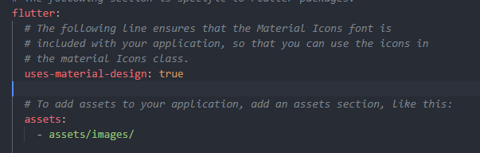


Text and Image
Text is a basic text widget
Takes a string as the first argument
The style property can be used with a TextStyle object to style the widget
Image is a basic image widget
You need to add the assets folder to your pubspec.yaml
You can use the image property with an AssetImage
You can also use the Image.asset factory constructor

Slide 12
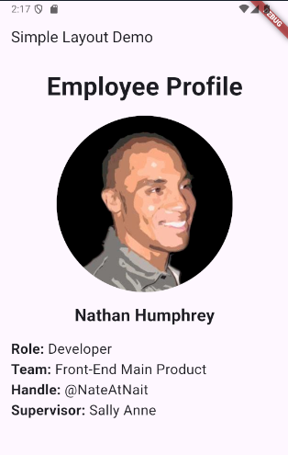
How would you layout this app?

Slide 13
Where to find other widgets?
https://docs.flutter.dev/ui/widgets
https://docs.flutter.dev/ui/widgets/material
https://api.flutter.dev/flutter/widgets/widgets-library.html

